Slide 1
Team Project 1
Members: Giselle Picardo Hanlu Chen Kurt Wang Leandra Menezes

Slide 2
Challenges Faced
Dim_geo_zip – Accuracy problem
Data conversion for various sources
Metadata issues - Replicating the same SSIS job across sources
Job Tracker and Job Status – Memory space limitation

Slide 3
What did we learn?
Data integration across multiple sources
Precision Control
Handling data conversion issues
New features in SSIS – Data Conversion, Derived Columns, Union All, Multicast, Execute T-SQL Task
Truncating the table before every load
Hash I/P and Hash O/P
Backup before every revise
Analysis using PowerBI

Slide 4
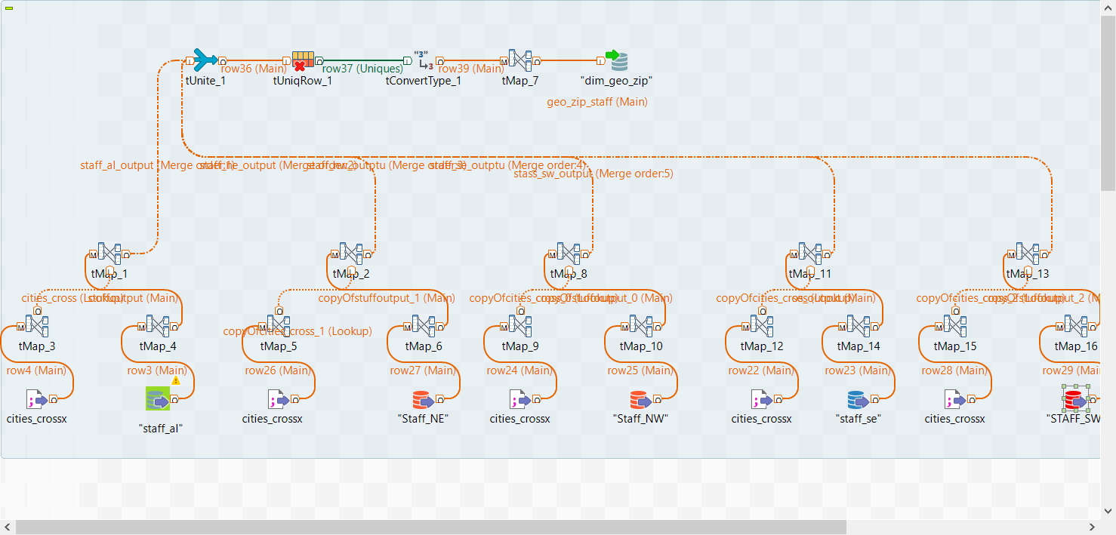
Talend – Dim_Geo_Zip

Slide 5
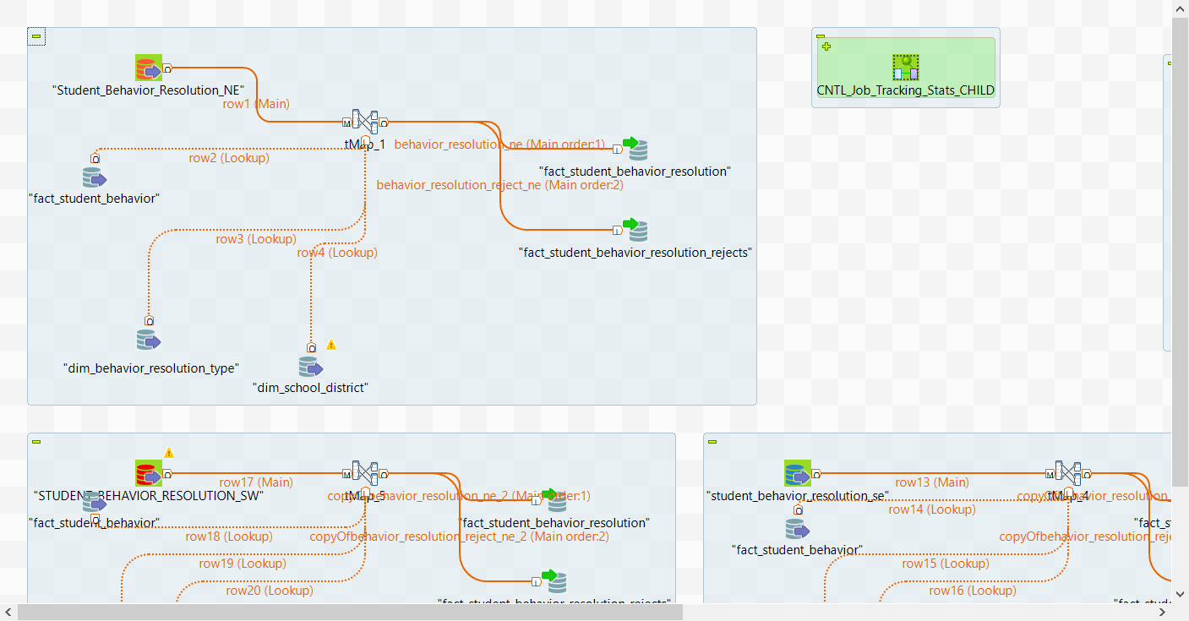
Talend – Fact_Student_Behavior

Slide 6
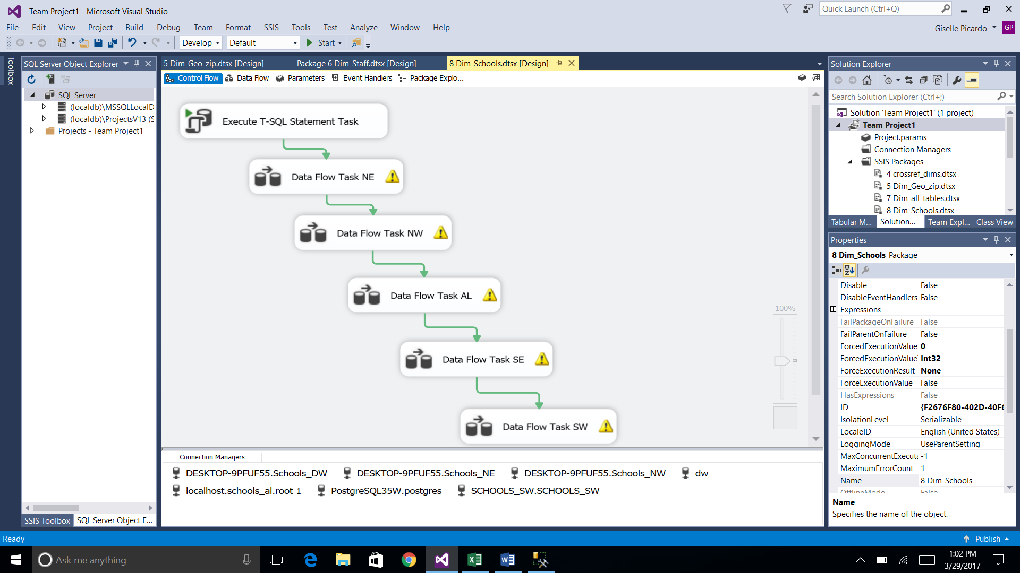
SSIS – Dim Schools

Slide 7
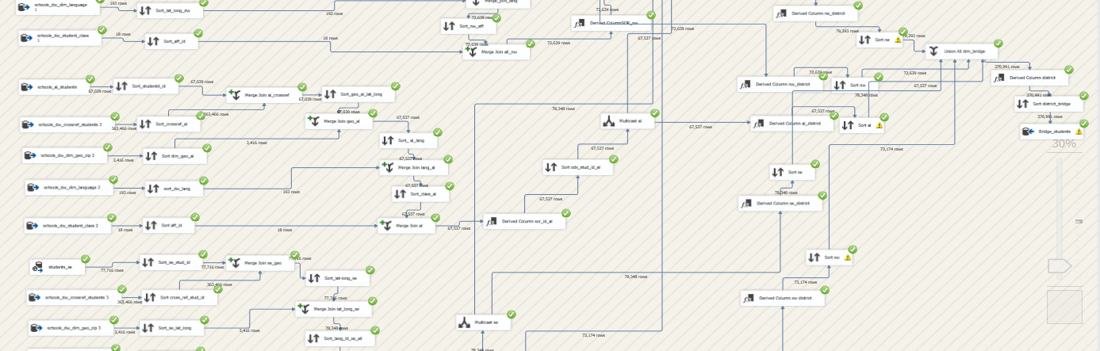
SSIS – Dim Students & Bridge

Slide 8
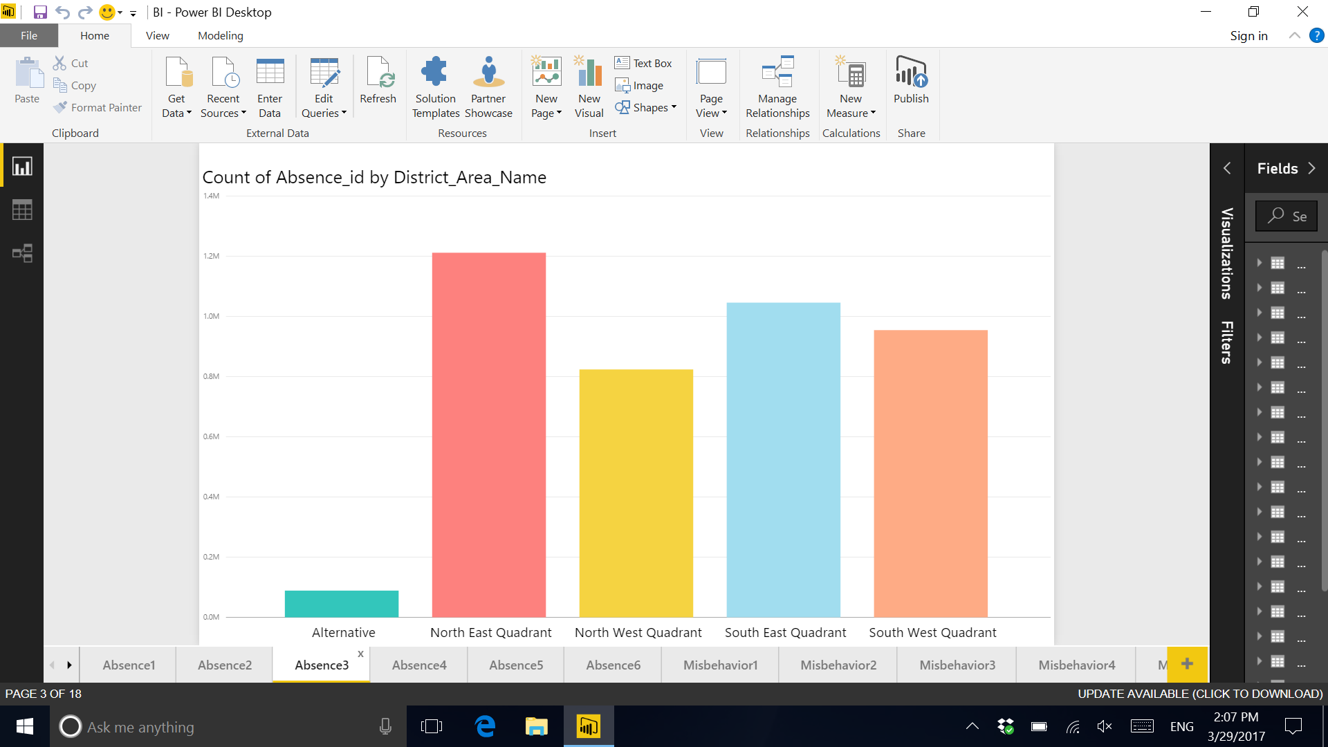
Absences by District - PowerBI

Slide 9
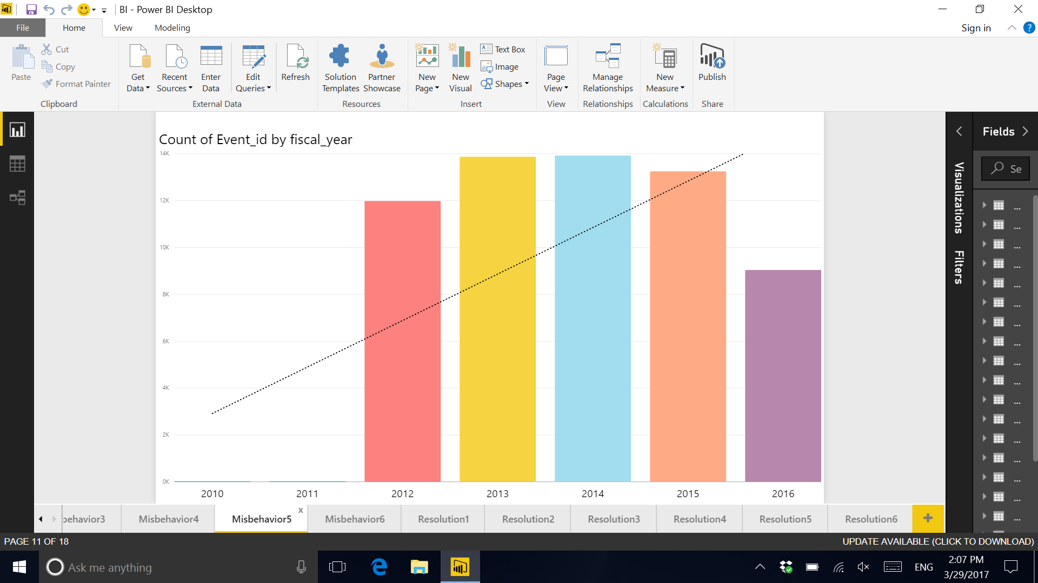
Misbehaviors trends - PowerBI

Slide 10
Thank you!

